Slide 1
IPs and Protocols
Networking 2, Day 1

Slide 2
Class Objectives
By the end of today’s class, you will be able to:
Explain how DHCP and NAT assist with the transmission of data from private to public networks and from public to private networks.
Analyze packet captures to diagnose potential DHCP issues on a network.
Optimize routing schemes by determining the shortest or quickest paths between multiple servers.
Use Wireshark to visualize wireless beacon signals, capture BSSIDs and SSIDs, and determine the type of wireless security being used by WAPs.
Use Aircrack-ng to obtain a wireless key and decrypt wireless traffic to determine security risks.
2

Slide 3

Let’s Review
Private IP addresses are used for devices within a Local Area Network (LAN).
Public IP Addresses are used for devices that are publically accessible on a Wide Area Network (WAN).
3
Notes:
Image source: AdobeStock_224845489

Slide 4
Dynamic Host Configuration Protocol (DHCP)
4

Slide 5

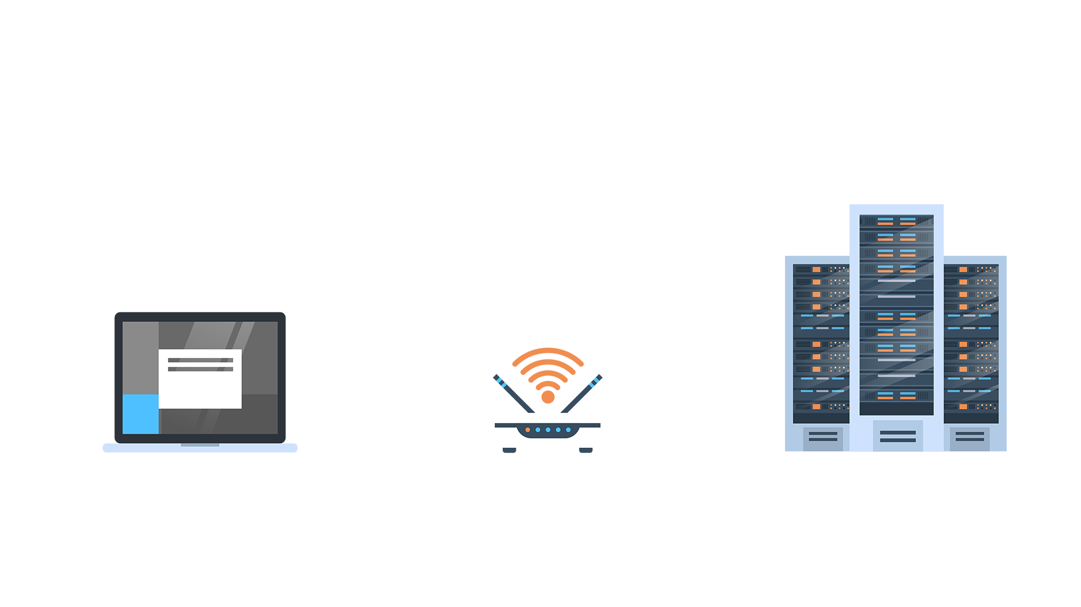
Several processes are taking place when we connect to the internet…
?
?
LAN
WAN
5
Notes:
Image source: shutterstock_697523956

Slide 6
Dynamic Host Configuration Protocol (DHCP)
For a computer on a LAN to connect to a webpage, it first needs to be assigned a private IP Address.
The Dynamic Host Configuration Protocol (DHCP) is a client-server based protocol on your local network responsible for managing and providing these IPs.
LAN
WAN
6

Slide 7
DHCP Fact List
DHCP is dynamic, because most devices do not have fixed IP addresses.
DHCP serves the DHCP clients—all devices needing a dynamic IP address.
DHCP is a Layer 7: Application protocol that uses two UDP ports:
Port 67 is used by the server.
Port 68 is used by the client.
Layer 7: Application
Layer 6: Presentation
Layer 5: Session
Layer 4: Transport
Layer 3: Network
Layer 2: Data Link
Layer 1: Physical
7

Slide 8
DHCP Request and Receive Four-Step Process
1
DHCP Discover Client finds the server.
2
DHCP Offer
The server checks available IPs, selects one, and sends it back over the network.
3
DHCP Request Client sends a message accep
accepting the IP.
4
Server tells client the IP is valid for the DHCP lease time, after which it can be sent to another machine.
DHCP ACK
8

Slide 9
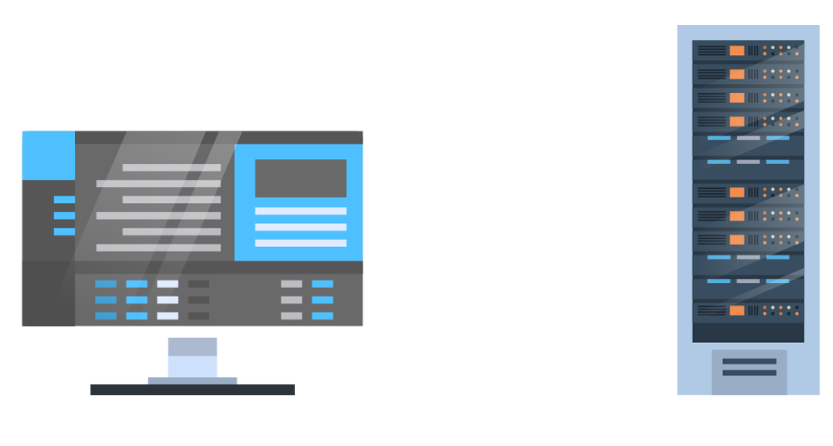

Four-Step Process
DHCP Discovery
Discover: “I need a DHCP Server!”
DHCP Offer
Offer: “Here is your IP Address.”
DHCP Request
Request: “Thanks for the IP address, I’ll take it.”
DHCP Acknowledge
ACK: “Okay, but I’ll need it back after a certain period of time.”
9

Slide 10
Let’s visualize these four steps using PCAP files in Wireshark.
10

Slide 11
DHCP Walkthrough

Slide 12
NAT
12

Slide 13
The device now has a private IP address, but it still needs to connect to a WAN in order to access public data like websites.
?
13

Slide 14

Network Address Translation (NAT) is a method of mapping a private IP address to a public IP address and vice versa.
14

Slide 15
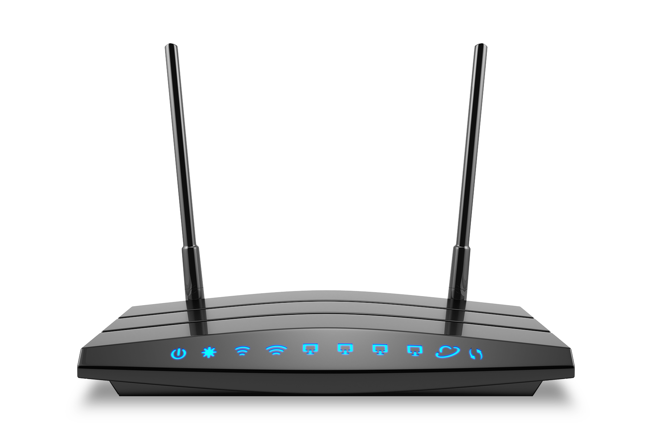
NAT
Mappings gets stored in a Network Address Translation Table.
NAT tables are managed by the router, considered the gateway between private and public networks.
NAT touches several OSI layers, but it's main task is IP address translation, so it primarily works on Layer 3: Network.
15
Notes:
Image source: Shutterstock_447377149

Slide 16

Step-by-Step Walkthrough
We’ll walk through the steps of NAT using the following scenario:
Your computer, with the private IP 10.0.0.5, is trying to access the webpage google.com, which has the public IP 74.0.0.1.
Your network’s public IP address is 32.0.0.1.
16

Slide 17
Step One: Creating the Packet
First, your computer creates a packet with the following info:
Destination IP and port: 74.0.0.1:80
Source IP and port: 10.0.0.5:49200
Packet
Destination IP and Port | 74.0.0.1:80
Source IP and Port | 10.0.0.5:49200
17

Slide 18
Step Two: Packet to NAT Table
The packet will be sent to the internal router, which creates a record in the NAT table.
Packet from Private IP
Destination IP and Port | 74.0.0.1:80
Source IP and Port | 10.0.0.5:49200
NAT Translation Table
LAN Address | WAN Address
10.0.0.5:49200 | 32.0.0.1:49200
18

Slide 19
Step Three: Going Public
The router modifies the packet and replaces the source IP with the network’s public IP address.
Packet from Private IP
Destination IP and Port | 74.0.0.1:80
Source IP and Port | 10.0.0.5:49200
NAT Translation Table
LAN Address | WAN Address
10.0.0.5:49200 | 32.0.0.1:49200
Packet Going Public
Destination IP and Port | 74.0.0.1:80
Source IP and Port | 32.0.0.1:49200
19

Slide 20
Step Four: Source Receives and Responds
Google.com receives the packet and then responds with the another packet:
Incoming Packet
Destination IP and Port | 74.0.0.1:80
Source IP and Port | 32.0.1.5:49200
Responding Packet
Destination IP and Port | 32.0.0.1:49200
Source IP and Port | 74.0.0.1:80
Google Server: IP 74.0.0.1
20

Slide 21
Step Five: Back to NAT
When the router receives the packet, it checks the NAT table and knows exactly which device is expecting this packet.
It will update the packet and translate the IP to include the following new packet details:
Destination IP and Port: 10.0.0.5:49200
Source IP and Port: 74.0.0.1:80
Incoming Packet
Destination IP and Port | 10.0.5.1:49200
Source IP and Port | 74.0.0.1:80
NAT Translation Table
LAN Address | WAN Address
10.0.0.5:49200 | 32.0.0.1:49200
Responding Packet
Destination IP and Port | 32.0.01:49200
Source IP and Port | 74.0.0.1:80
21

Slide 22
Step Six: Return of the Packet
Your device, with private IP 10.0.0.5 receives the packet. You can now view google.com.
Google
Receiving Packet
Destination IP and Port | 10.0.0.5.1:49200
Source IP and Port | 74.0.0.1:80
NAT Translation Table
LAN Address | WAN Address
10.0.0.5:49200 | 32.0.0.1:49200
Responding Packet
Destination IP and Port | 32.0.01:49200
Source IP and Port | 74.0.0.1:80
22

Slide 23
DHCP Attacks
23

Slide 24

DHCP Attacks
DHCP servers only have a limited amount of IP addresses they can distribute to devices on a LAN.
If an attacker is able to access the LAN, they can send a large number of DHCP messages over the network requesting IP addresses from the DHCP server.
If the number of requests is large enough, the DHCP server can run out of IPs, and new, legitimate users won’t be able to receive an IP.
24
Notes:
Image source: shutterstock_552746107

Slide 25



DHCP Attacks
This attack is known as DHCP starvation.
If it sounds familiar, this is because it’s a type of denial of service (DoS) attack.
This attack impacts the availability concept of the CIA triad.
Confidentiality
Integrity
Availability
25
Notes:
Image source: shutterstock_249899182 (triangle); AdobeStock_108761682 (laptop, darts)

Slide 26
Visualizing DHCP Starvation
26

Slide 27
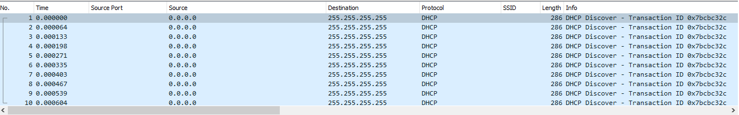
Visualizing DHCP Starvation
Now, we’ll visualize a DHCP starvation attack by opening up the following pcap file in Wireshark.
27

Slide 28


Preventing DHCP Starvation
One way to prevent DHCP starvation is to set a maximum threshold. This threshold is the number of DHCP requests a server can accept per second.
28
Notes:
Image source: Marcin Sasin

Slide 29
DHCP Spoofing
After a DHCP starvation attack occurs, an attack can potentially set up a fraudulent DHCP server.
The fraudulent server can send spoof messages, assigning clients to a malicious router.
The attacker can use this router to capture sensitive data.
This attack is known as DHCP spoofing.
29

Slide 30



Legitimate DHCP Server
Hey DHCP, I need an IP address!
Legitimate User
I’m out of IP addresses.
switch
I’ve got one for you. Send your traffic to this router.
Malicious Actor and Spoof DHCP Server
30
Notes:
Image source: shutterstock_697523956 (computers, server, switch); AdobeStock_204650616 (hacker icon); shutterstock_348430685 (switch icon)

Slide 31
Legitimate DHCP Server
Thanks, here is my login request for my bank account.
Legitimate User
switch
Ha! I captured your bank account login! $$$!
Malicious Actor and Spoof DHCP Server
31

Slide 32
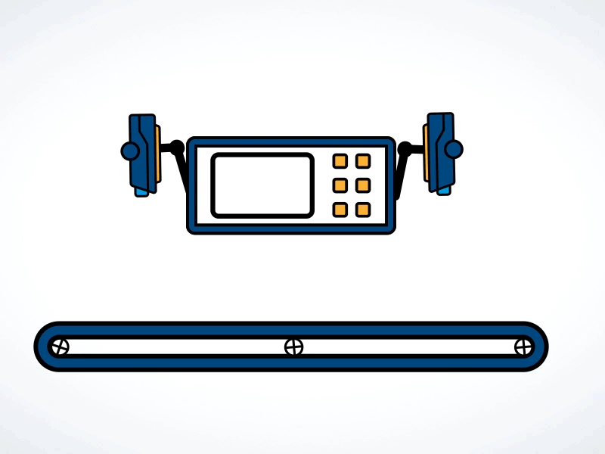
Preventing DHCP Spoofing
DHCP snooping is a process implemented on a network switch that inspects packets to confirm that they’re legitimate DHCP offers.
32
Notes:
Image source: Adam Zimmer

Slide 33
Activity: DHCP Attacks
In this activity, you will continue to play the role of a security analyst at Acme Corp.
You will analyze a packet capture to determine what type of attack may be causing network issues for Acme employees.
15 Minutes
33

Slide 35
Routing Schemes and Protocols
35

Slide 36

Routes
Data takes routes from source to destination.
Routing is the act of choosing
the path that traffic takes in or
across networks.
36
Notes:
Image source: AdobeStock_96530855

Slide 37
Routing Schemes
Network devices have several routing schemes to choose from:
Unicast
Broadcast
Multicast
A single device delivers a message to another single specific device.
A single device broadcasts a message to all devices on that same network.
A device sends a message to devices that have expressed interest in receiving the message.
37

Slide 38

Routing Scheme Examples
Unicast
Broadcast
Multicast
A phone call between two people.
DHCP offer message that is broadcast across an entire LAN.
A subscription-based service sends network traffic to its subscribers.
38
Notes:
Images source: shutterstock_697523956

Slide 39
Comparing the Schemes
Disadvantages of each:
Unicast
Broadcast
Multicast
If the message has to reach multiple destinations, many unicast messages must be sent.
Since broadcast messages are sent to everyone on a network, they can cause unnecessary traffic.
Intended recipients will need to be updated and maintained to make sure they're accurate.
39

Slide 40

Routing Techniques
Devices want to make sure traffic is sent as efficiently as possible.
Networks use two primary routing techniques to determine the path: static and dynamic routing.
40
Notes:
Image source: Bastien Genbrugge

Slide 41
Static Routing
Static routing is the manual configuration of a network route, typically done by a network administrator.
Usually used on smaller networks.
Advantages: lower CPU on the router, network administrator has full control of their network's routing behavior.
Disadvantages: fault tolerance, meaning if a device on a manually created path fails, the route can't be adjusted.
41

Slide 42
Dynamic Routing
Dynamic Routing prevents fault tolerance issues by allowing the network to act autonomously in order to avoid network blockages.
Network is adaptive and data gets forwarded on a different route depending on the network conditions.
Primary routing technique used over the internet.
Uses routing protocols to determine the best route.
42

Slide 43

Routing Protocols
There are several dynamic routing protocols used to determine the path traffic takes to reach its final destination.
The two primary criteria are
distance and speed.
43
Notes:
Image source: SriKaleeswarar

Slide 44

Distance
Distance is the number of hops (devices) it takes to get from the
source to the destination.
Dynamic routing protocols that use distance as criteria are distance-vector routing protocols.
Protocols include:
Routing Information Protocol (RIP)
Enhanced Interior Gateway Routing Protocol (EIGRP)
44
Notes:
Image source: AdobeStock_159062233

Slide 45

Speed
The route is determined by the time it takes to move from source to destination.
Dynamic routing protocols that use speed as criteria are
link-state routing protocols.
One protocol is Open Shortest Path First (OSPF).
45
Notes:
Image source:

Slide 46
Distance vs. Speed
Just because a route has more hops, doesn't mean it's always slower. For example, the path with more hops might be faster if there's network congestion on the path with fewer hops.
B
3
3
A
8
C
46

Slide 47
Activity: Routing Schemes and Protocols
In this activity, you will continue playing the role of a security analyst at Acme Corp.
Your task is to analyze a network diagram and identify the shortest (time-wise) path between the servers.
15 Minutes
47

Slide 49


49
Notes:
Image source: AdobeStock_56885471

Slide 50
Going Wireless
50

Slide 51

You may
already know that
wireless technologies communicate data through air and space without using wires.
51
Notes:
Image source: shutterstock_712909117

Slide 52

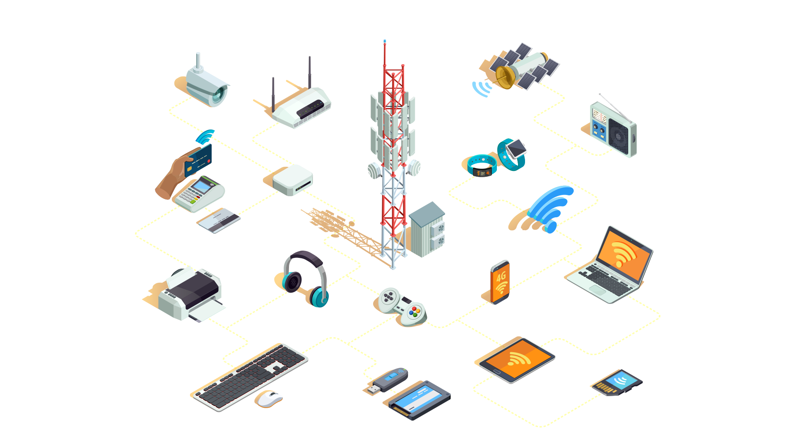
Wireless Networking
WiFi is a wireless technology that uses radio waves to provide wireless internet and network connections.
Devices that use WiFi have a standard called 802.11.
52
Notes:
Image source: shutterstock_531055615

Slide 53
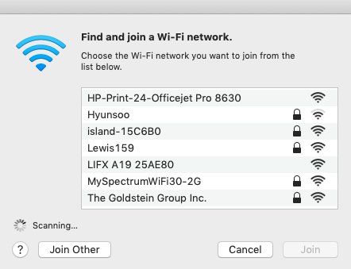
Connecting to WiFi Networks
Wireless access points (WAPs) broadcast a signal called a beacon that computers detect and tune into.
53

Slide 54

Wireless Networking
When a WAP needs to broadcast its signal, it must identify itself with a
Basic Service Set Identifier (BSSID).
These BSSIDs are not easily recognizable. For example: 00-A4-22-01-53-45. So WAPs also broadcast Service Set Identifiers (SSID). For example:
Austin Public Library
Airport Wifi
Starbucks_Public
New England Clam Router
This LAN is my LAN
Abraham Linksys
54
Notes:
Image source: MUTI

Slide 55

Wireless Security
Can an attacker capture and view private wireless network traffic?
(Yes!)
55
Notes:
Image source: shutterstock_1095422036

Slide 56
How Do We Secure WiFi?
WEP
WPA
WPA2
First, there was Wired Equivalent Privacy (WEP), a security protocol using encryption to provide protection and privacy to wireless traffic.
Major vulnerabilities made WEP obsolete, replaced by a more secure, sophisticated protocol called WiFi Protected Access (WPA).
Finally, an even more secure protocol, WPA2, came along. This is currently the most commonly used protocol.
56

Slide 57

In the following demo, we
will use Wireshark to visualize wireless beacon signals, capture BSSID and SSIDs, and
determine which wireless
security protocol is being
used by the WAPs.
57

Slide 58
Visualizing Wireless in Wireshark
58

Slide 59
Activity: Analyzing Wireless Security
In this activity, you will continue to play the role of a security analyst at Acme Corp.
You will analyze your traffic capture from the Kansas City office, determine which wireless routers are in the office, and the routers’ SSIDs, BSSIDs, and type of security.
15 Minutes
59

Slide 61
Wireless Attacks
61

Slide 62
In the following walkthrough, we will demonstrate how to use a tool
called Aircrack-ng to decrypt WEP-encrypted wireless traffic.
62

Slide 63
Decrypting with Aircrack-ng
63

Slide 64

Cybercriminal Tactics
How cyber criminals can find weak wireless security routers that are available for exploit:
Wardriving: Driving around an area with a computer and a wireless antenna to find wireless LANs that may be vulnerable.
Look up: warchalking symbols
Warchalking: Marking locations with chalk so sites can be exploited these access points at a later time.
Warflying: Using drones to find vulnerable access points.
64
Notes:
Image source: Rob Diaz

Slide 65



Cybercriminal Tactics
Cybercriminals can also create a fake WAP called an evil twin:
When using an evil twin, an attacker can make a fake SSID to trick unsuspecting users into connect to the attacker's wireless access point.
Starbucks-Wifi
FreeWiFi-2Gi
65
Notes:
Image source: shutterstock_1198495231

Slide 66
Activity: Wireless Attacks
In this activity, you will continue to play the role of a security analyst at Acme Corp.
You must analyze a packet capture, obtain a wireless key, and decrypt wireless traffic in order to determine the associated security risks.
15 Minutes
66

Slide 68
Class Objectives
By the end of today’s class, you will be able to:
Explain how DHCP and NAT assist with the transmission of data from private to public networks and from public to private networks.
Analyze packet captures to diagnose potential DHCP issues on a network.
Optimize routing schemes by determining the shortest or quickest paths between multiple servers.
Use Wireshark to visualize wireless beacon signals, capture BSSIDs and SSIDs, and determine the type of wireless security being used by WAPs.
Use Aircrack-ng to obtain a wireless key and decrypt wireless traffic to determine security risks.
68

